Slide 1
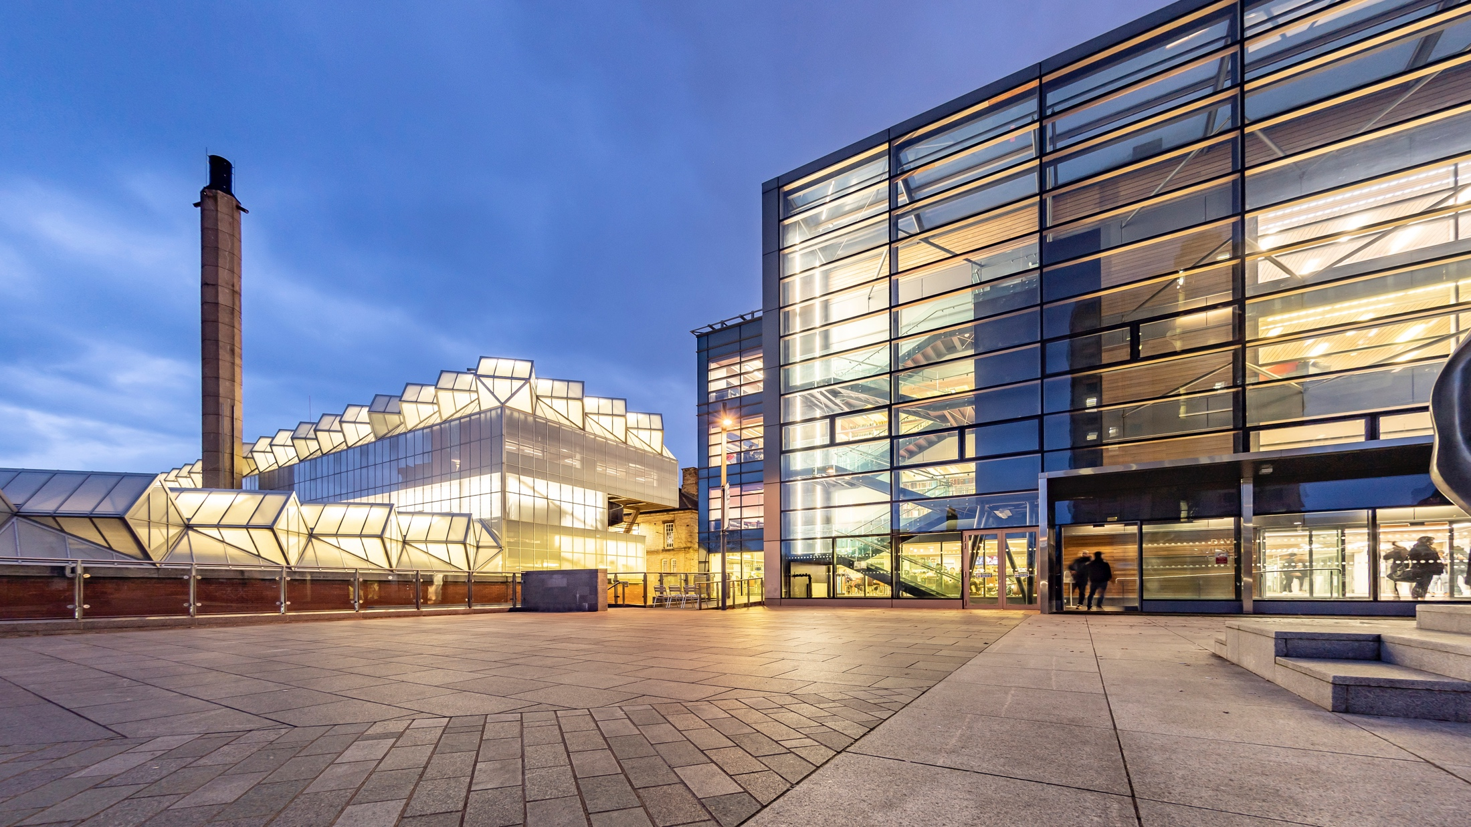
Gendev Bot v.1.1 Build and Run
Jan O. Ringert

Slide 2
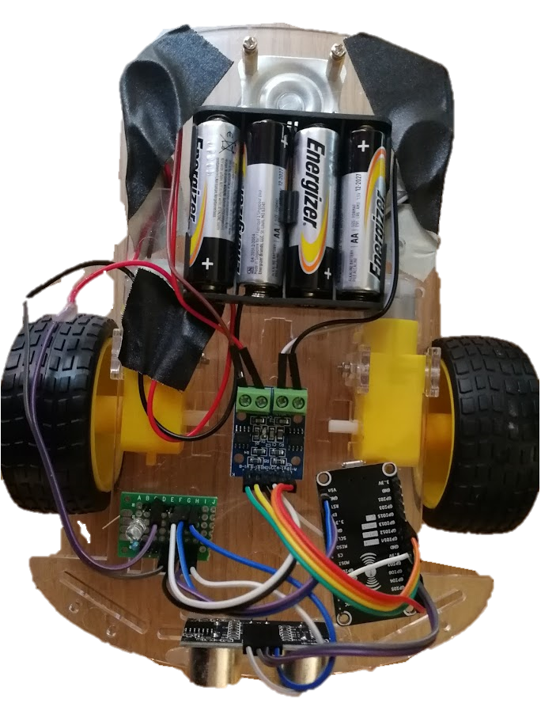
Physical View

Slide 3
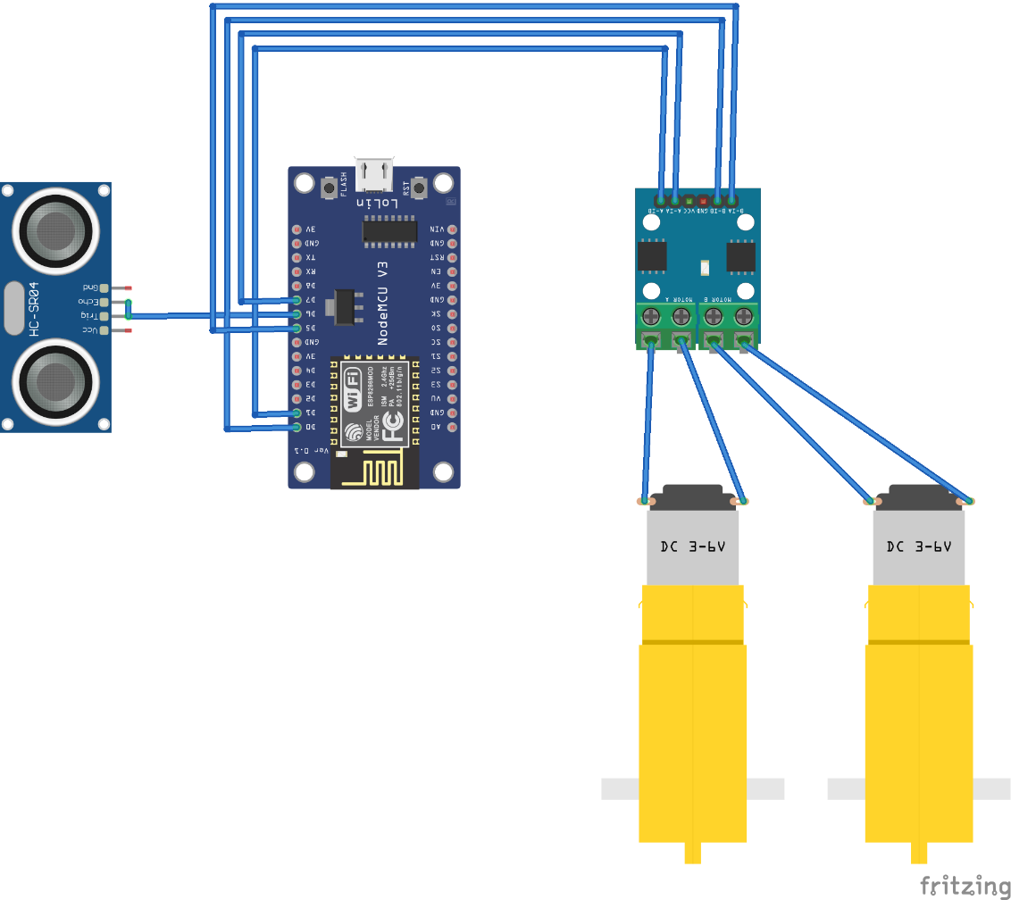
Data Connections
A-1B -> D1 A-1A -> D7
B-1B -> D0 B-1A -> D5
Trig -> D6
Echo -> Trig

Slide 4
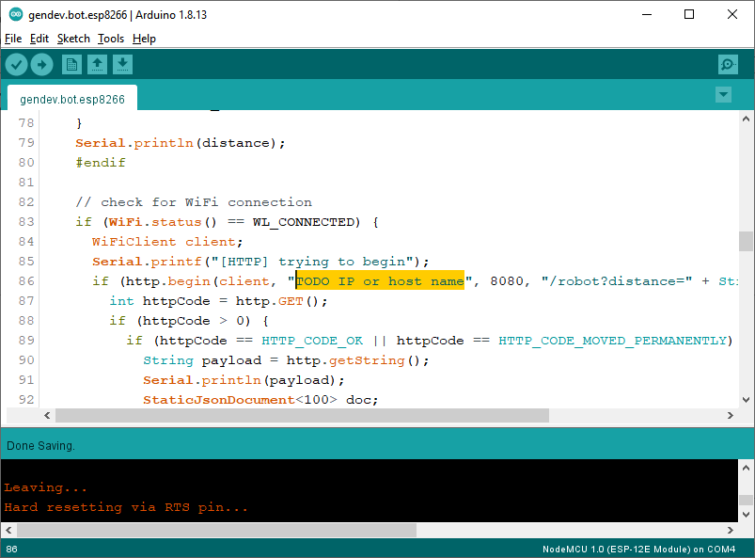
Uploading Code to Robot

Slide 5
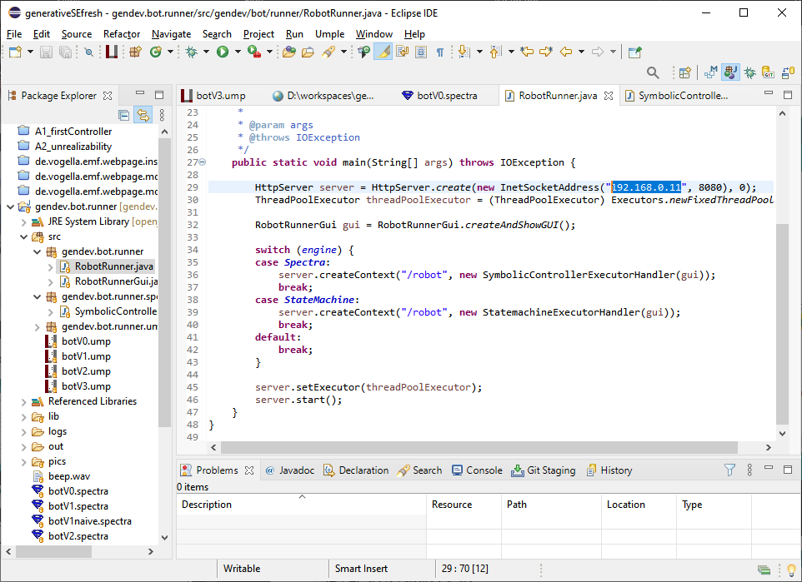
Preparing Java HTTP Server

Slide 6
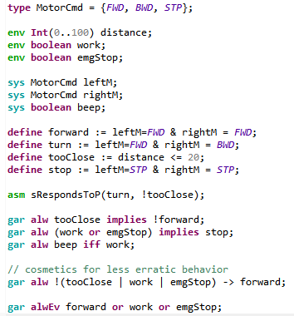
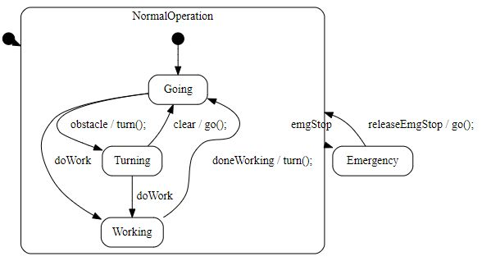
Engine Selection and Code Generation/Synthesis

